Slide 1
Introduction to Computer Programming Lecture 7.1:
Importing Packages: Numpy User Input
Hemma Philamore
Department of Engineering Mathematics

Slide 2
Import
Import modules written by developers using import keyword
NumPy ("Numerical Python"): scientific computing applications
Fourier Transform
Shape Manipulation
Mathematical and Logical Operations
Linear Algebra
Random Number Generation
Advantages
Fast (uses C and Python)
Other libraries (data science, machine learning…) based on Numpy
Extensive built-in functionality

Slide 3


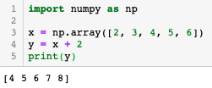
Elementwise Operation
Pure Python
Import numpy module
(Often renamed as np)
Simpler way to add 2 to each element
Numpy
New type of data structure
Numpy operations act elementwise, when applied to a numpy array

Slide 4


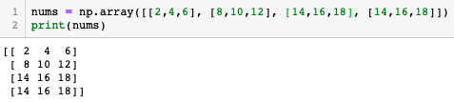

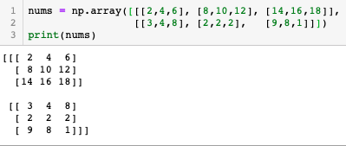

Numpy Array
Indexing
Create 1D array from list
1D
1D
Create 2D array from list of lists
row
2D
column
Every inner list becomes a row.
Number of columns is equal to the number of elements in each inner list.
matrix
matrix
Create nD array from lists of lists
nD
row
column

Slide 5




Numpy Array
Indexing
range
Create 1D array from list
1D
Up to column 1
Create 2D array from list of lists
2D
Every inner list becomes a row.
Number of columns is equal to the number of elements in each inner list.
column
Inner brackets are column
All rows
Create nD array from lists of lists
nD
Column 1 to
end
Notes:
Photobomb edit

Slide 6





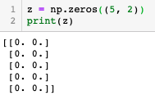
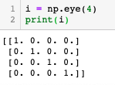
Numpy Array
arange
ones
Step size of 2
Number of equally-spaced elements
linspace
zeros
tuple
Identity matrix:
Square matrix with zeros across rows and columns except the diagonal
eye

Slide 7

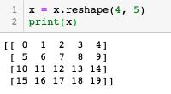
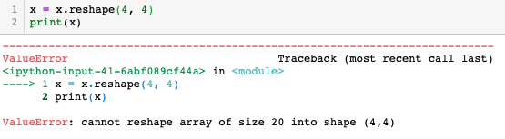
Re-shaping
2D array, 4 rows,
5 columns
Number of elements in the 1D array not equal to the number of elements in reshaped array
(e.g. product of rows and columns)

